Slide 2

Developer's Legacy Tools
Jay Gohil and Jay Patel

Slide 3
Git and Github

Slide 4
What's Git and Github, and why use it?
Git is basically a version control system.
Keeps a record of changes for us.
Allows collaborative development.
Provides information on who made which changes.
Allows to revert back to any changes and go to previous state.
Github is the largest web-based git repository hosting service.
Provides online remote git repositories.
Allows collaborative development on the web.
Provides extra features on top of git (like UI and documentation).
Acts as a social platform to share knowledge and work, while aiding us in making open source contributions.

Slide 5
Github Terminologies:
Repository
Branch
Fork
Clone
Commit
Pull Request
Master
Markdown Syntax

Slide 6
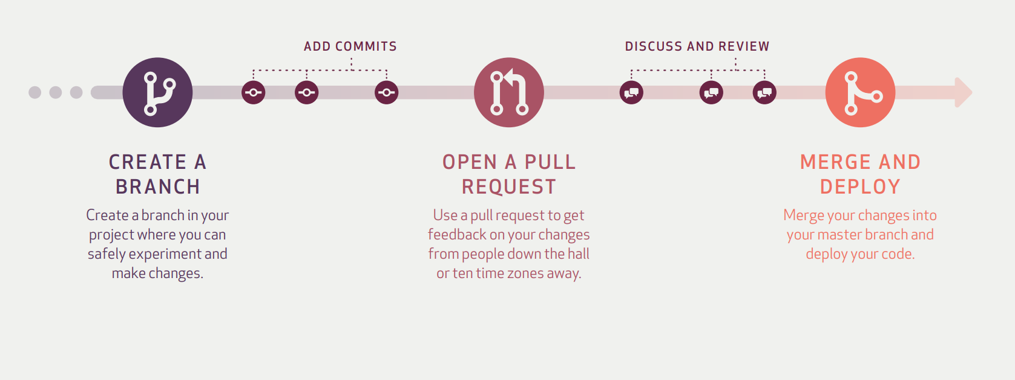
Workflow of Github:

Slide 7
Few useful resources
Official Git site and tutorial: https://git-scm.com/
Github guides: https://guides.github.com/
Help guide: https://help.github.com/
Command Cheatsheet: https://training.github.com/kit/downloads/github-git-cheat-sheet.pdf

Slide 8
Let's begin with the hands-on session!

Slide 9
Closer look into Git:
Git is an open source distributed version control system.

Slide 10
Open Source: It refers to something that's available to all the user at free of cost. Version Control System: The code which is stored in Git keeps changing as more code is added. Also, many developers can add code in parallel. So Version Control System helps in handling this by maintaining a history of what changes have happened. Also, Git provides features like branches and merges, which I will be covering later. Distributed Version Control System: Git has a remote repository which is stored in a server and a local repository which is stored in the computer of each developer. This means that the code is not just stored in a central server, but the full copy of the code is present in all the developers’ computers. Git is a Distributed Version Control System since the code is present in every developer’s computer.

Slide 11
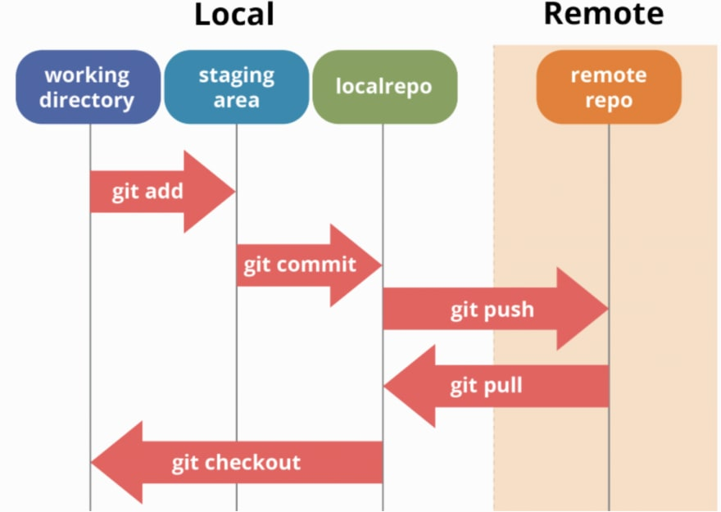
Workflow of Git with Github:

Slide 12
Let's begin with the hands-on session!

Slide 13
Effective Search Engine Usage

Slide 14
Bing Search Symbols:
+ Searches for web pages that contain all terms after '+' symbol
"" Searches for exactly whats written within ' "" ' symbols
&, AND Searches for both the terms before and after '&' symbol
-, NOT Searches after excluding the terms after '-' symbol
|, OR Searches for web pages that have either one or both of terms before and after '|' symbol

Slide 15
Bing Search Operators:
filetype: Searches for web pages that are based on that particular file type.
contains: Searches for web pages that have links to files of mentioned file-type.
ip: Searches for pages that are hosted on that specific ip address.
language: Searches for web pages that in that language. [Language codes]
loc: location: Searches for web pages that are from specific location. [Loc. codes]
intitle: inbody: inanchor: Searches for web-pages with specific terms in metadata.
prefer: Searches for web pages with emphasis on preferred terms.
site: Searches for web pages that belong to a specific domain.

Slide 16
Bing Image Search Filters:
Size: Filter out images based on size.
Color: Filter out images based on colors present inside the image.
Type: Filter out images based on type (transparant, animated, etc).
Layout: Filter out images based on layout (square, round, etc).
People: Filter out images based on whether image has faces or not.
Date: Filter out images based on image's existence.
License: Filter out images based on image's license (paid, free, etc).

Slide 17
Overview: Bing Developer Tools

Slide 18
Session: QnA

Slide 19
Thank You!

